Slide 1
Patient Experience Analytics from CAHPS Survey Data
CS 5525 Cloud Computing Project
Spring 2020
Team Members:
Yamini Reddy Dontireddy(16293335)
Satya Anusha Prattipati(16292575)
Madhuri Sarda(16291679)

Slide 2
Objective
The main objective of our project is to analyse CAHPS (Consumer Assessment of Healthcare Providers and Systems) Survey Data for health plans or providers and to gather insights on patient experience when they use employee sponsored or Medicare/Medicaid plans or health care service providers like physicians, hospitals and other healthcare facilities.
Motivation
Patient Experience Analysis would help plans and providers to,
Help measure performance at enterprise, facility and even at service / section level
Measure star rating to comply with CMS compliance for MA plans
Compare against another plan or provider through KPIs such as ranking, mean score and top box score.
Drive improvements and sustain quality of care

Slide 3

Patient Experience
Patient experience encompasses the range of interactions that patients have with the health care system, including their care from health plans, and from doctors, nurses, and staff in hospitals, physician practices, and other health care facilities. Understanding patient experience is a key step in moving toward patient-centered care.
CAHPS Surveys
CAHPS surveys cover topics that are important to consumers and focus on aspects of quality that consumers are best qualified to assess, such as the communication skills of providers and ease of access to health care services. All CAHPS surveys and related documentation are free to anyone who wants to use these surveys to assess patients' experiences with care.
This program was started under CMS (Centre for Medicaid and Medicare Services, a federal health care regulator) since 1995 to quality care in US.

Slide 4
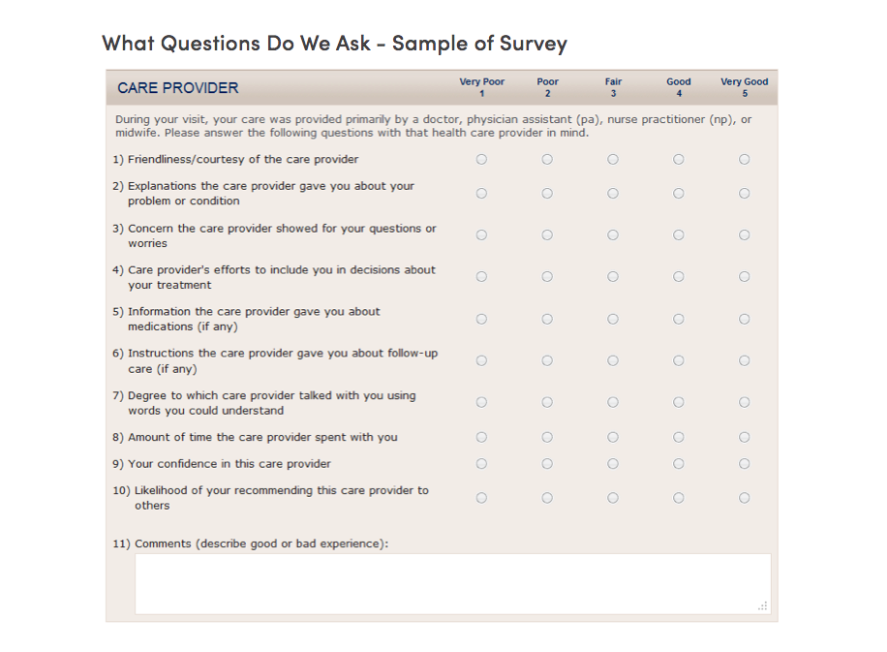
Sample Survey Data Sample

Slide 5
Architecture Design & Implementation environments
Architecture
Technologies
User
Interface
Patient Experience
Power BI or Angular
Angular & amcharts for visualization's
Dashboard 1
Dashboard 2
Services &
Data Access
AWS Cloud
Direct Read from BI
AWS
Data
JSON
CSV to JSON files
*** Used AWS for the Deployment of the application ***

Slide 6
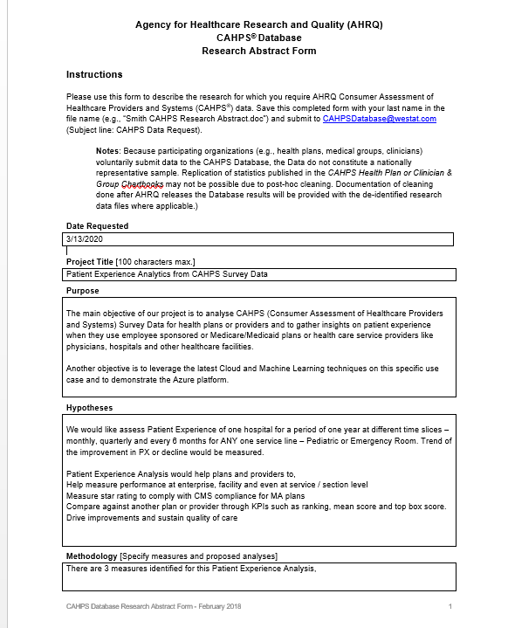
Dataset Gather Datasets from CHAPS.

Slide 7
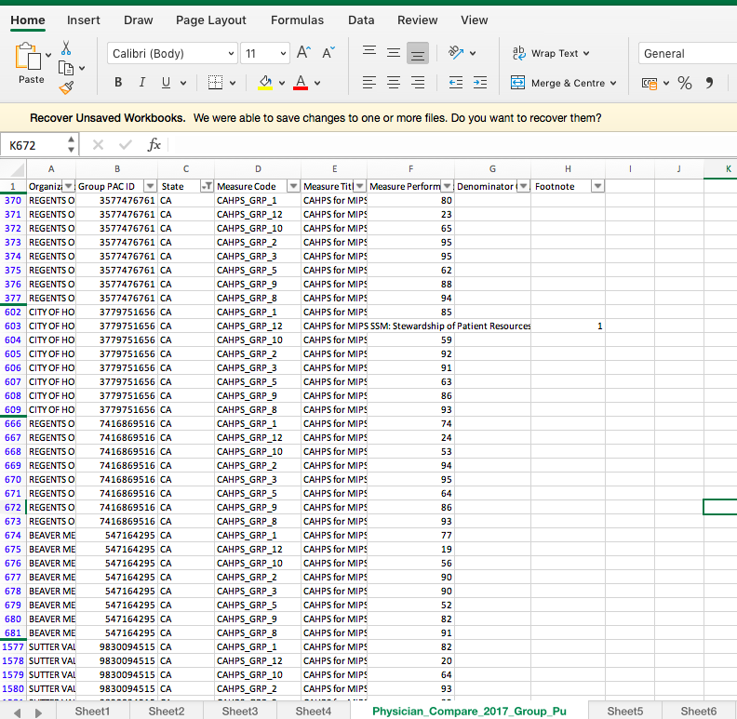
Data Analysis
The dataset has 1936 Surveys, that are spread across states and hospitals.
Each and every survey contains 8 set of questions.
The questions are mostly to understand the patient’s feedback.
Then these data sets are aggregated question wise and state wise.
Performance Dashboard – For each question, we aggregated the value at the state level.
Star rating dashboard – Based on the KPI scores, the star rating dashboard is generated.
Aggregated Dashboard – Aggregation of all CHAPS 8 survey questions.

Slide 8
New Findings - Requirements / KPIs
Analysis - Analyzing Requirements for Patient Experience – Identify service line, facility and data set
Surveys are initiated once the patient gets discharged from any hospital or diagnostic facility. This can be large hospital or medical practice or emergency room and even ambulatory/hospice care providers.
Surveys are accessed by Patients through multiple channels – IVR, Postal mail, online, esurvey etc. based on the customers preference and consent.
Responses are collected & aggregated for each patient based on the discharge date or survey response dates
Responses are aggregated at different levels such as servicelines, facility, enterprise and also across various time spans such as monthly, quarterly and annual. Compared with previous period (In Scope) and its peer group (Not in Scope).

Slide 9
KPI Definition Define Key performance measures for analyzing patient experience
Top Box Score
Question-level scores are calculated by taking the number of responses in the most desirable response category and dividing it by the total number of responses, excluding ignore values. Question-level n is determined by the number of respondents who answered that question.
Mean Score
The n of a question is the total number of responses to the question. The n of a section is the total number of unique responses in that section (i.e., not the sum of question responses). The overall n is the total number of unique responses and mean is calculated taking the average of all the responses.
Percentile Distribution
This would calculate the percentage distribution of CHAPS survey responses across various 5 categories.

Slide 10
KPI Definition Define Key performance measures for analyzing patient experience

Slide 11
Use case / Application Walkthrough

Slide 12
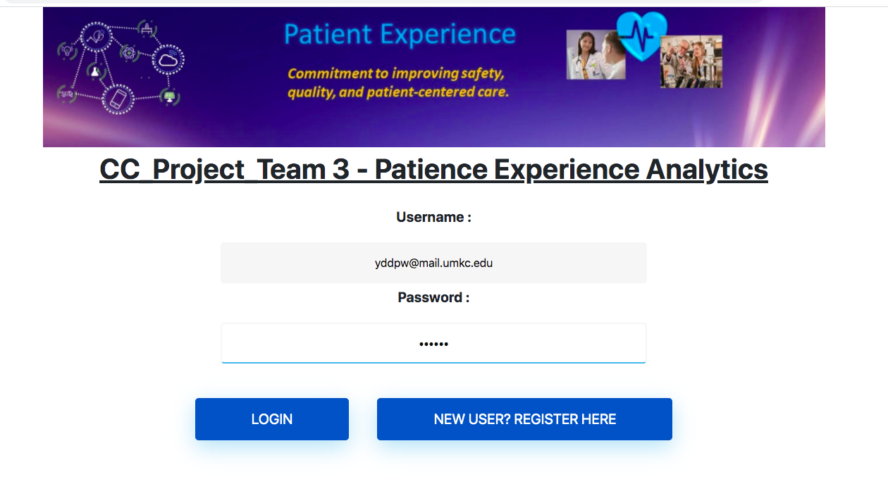
Sign-in Page
Existing users can directly log on to application and the new users should go for registration

Slide 13
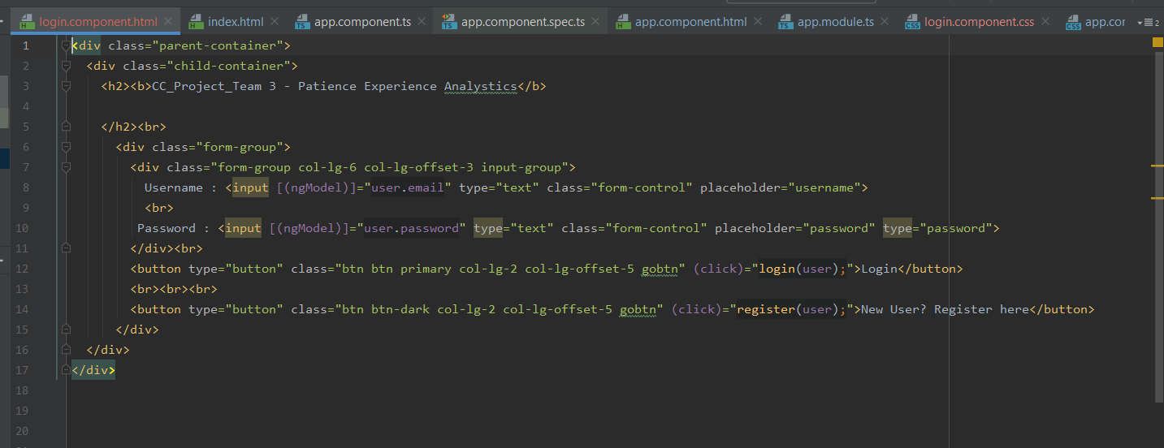
Angular Code

Slide 14
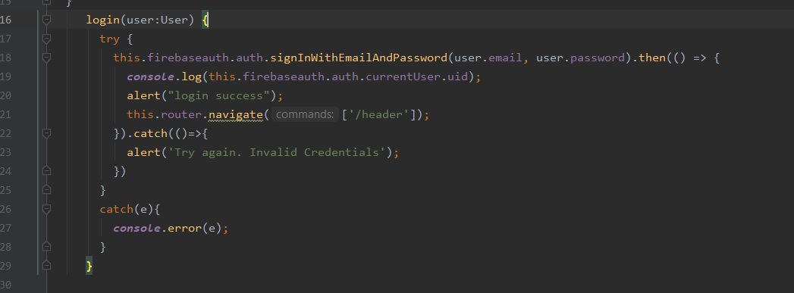
Code Snippets - Continuation

Slide 15
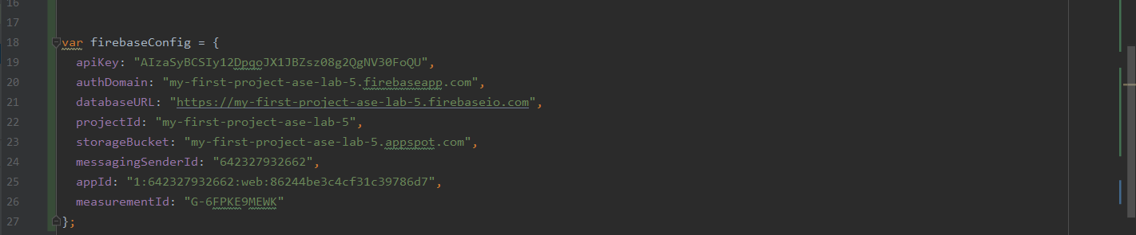
FireBase Configuration

Slide 16
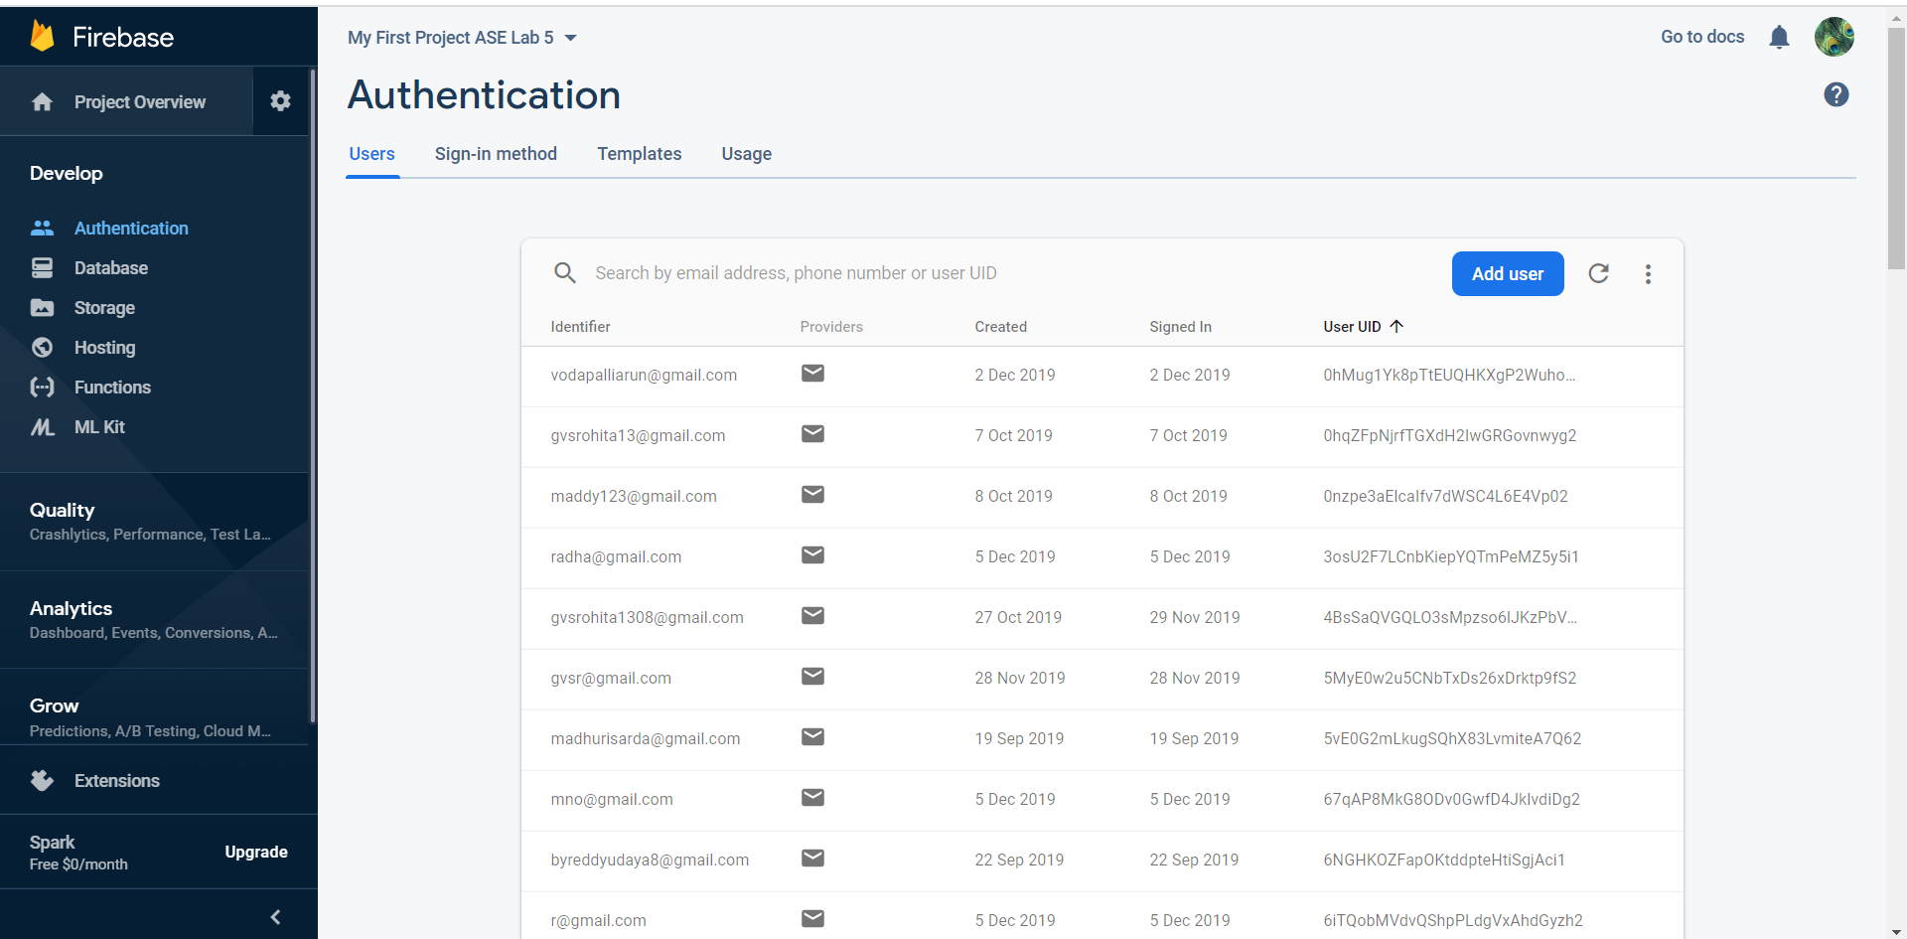
Registered Users in FireBase

Slide 17
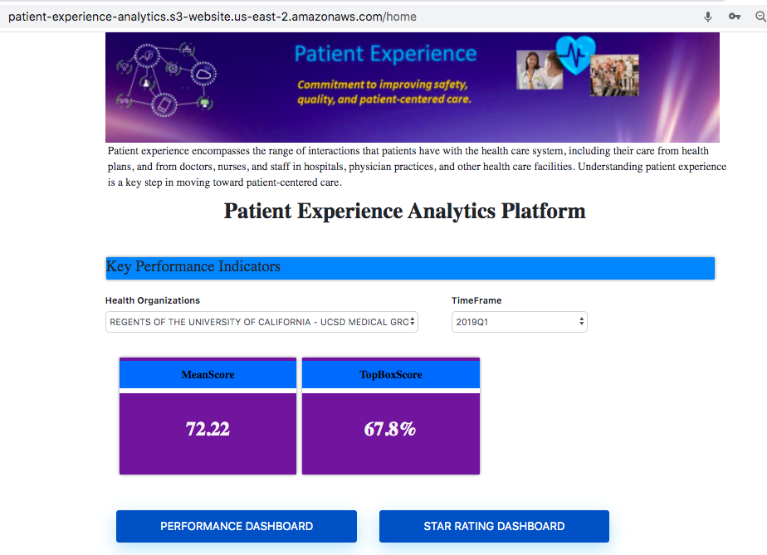
Landing Page

Slide 18
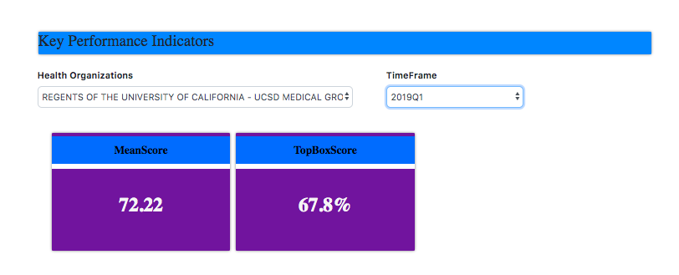
Key Performance Metrics

Slide 19
Performance Dashboard
8 different Survey questions:
CAHPS for MIPS SSM: Getting Timely Care, Appointments and Information.
CAHPS for MIPS SSM: How Well Providers Communicate
CAHPS for MIPS SSM: Patient's Rating of Provider
CAHPS for MIPS SSM: Health Promotion and Education
CAHPS for MIPS SSM: Courteous and Helpful Office Staff
CAHPS for MIPS SSM: Care Coordination
CAHPS for MIPS SSM: Between Visit Communication
CAHPS for MIPS SSM: Stewardship of Patient Resources

Slide 20
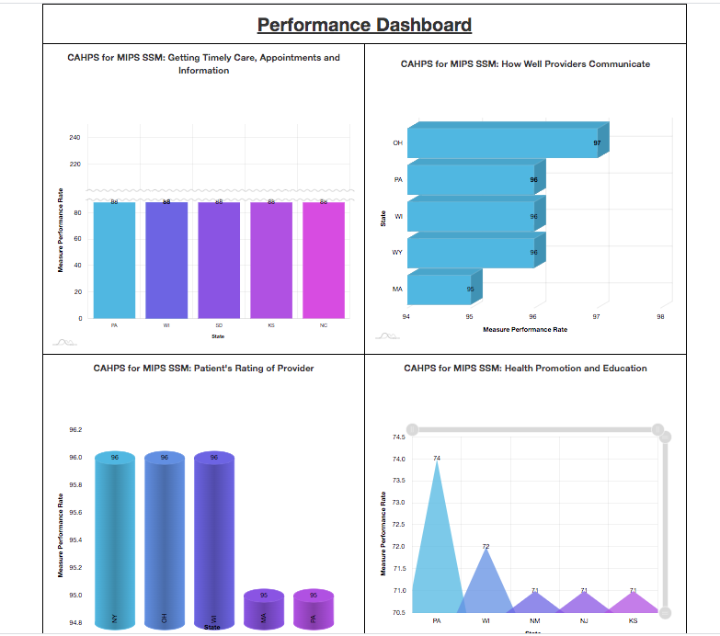
Performance Dashboard Visualizations
Note: Each and every Viz shows top five states in USA that are performing well in the respective CHAPS survey questions.

Slide 21
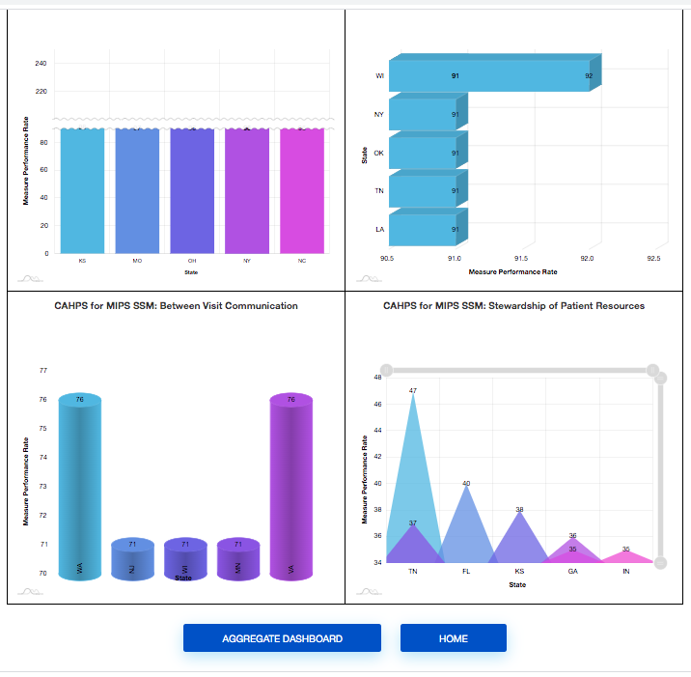
Performance Dashboard Viz Cont….

Slide 22
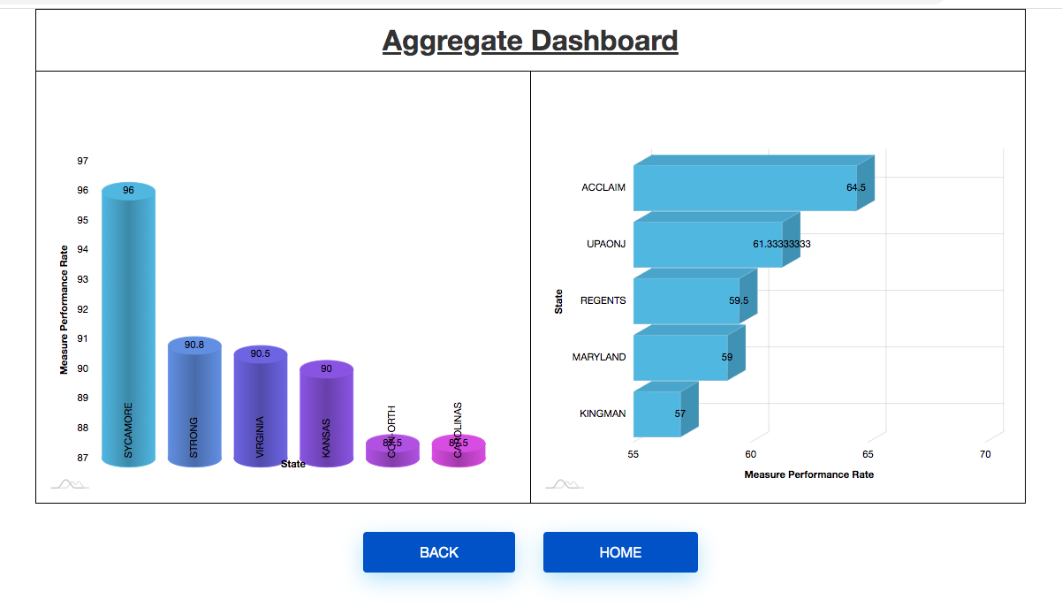
Aggregate Dashboard
Note: First Viz shows the top 5 Aggregation values w.r.t. to USA states of the CHAPS survey questions.
Second Viz shows the bottom 5 Aggregation values w.r.t to USA states of the CHAPS survey questions.

Slide 23
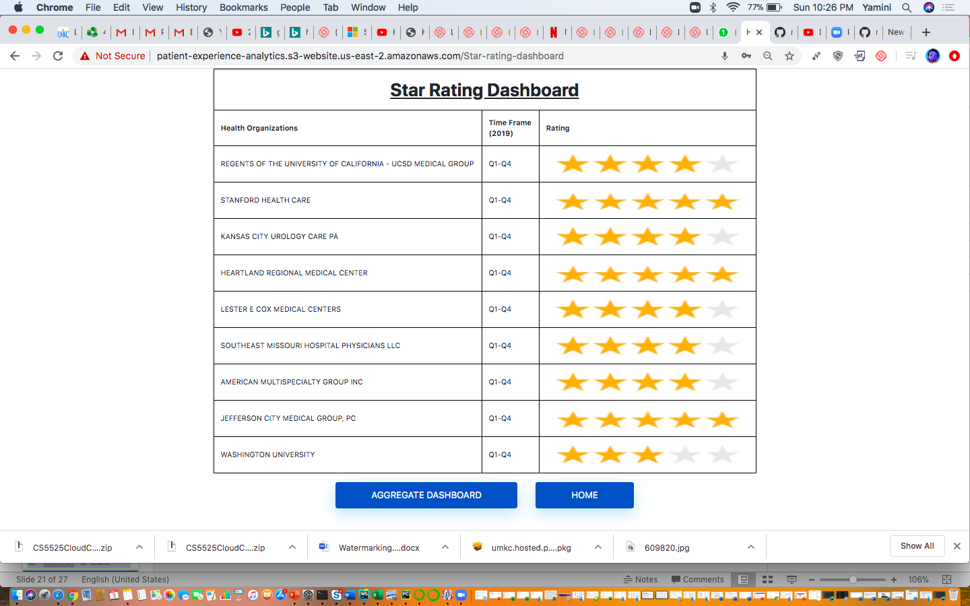
Star Rating Dashboard

Slide 24
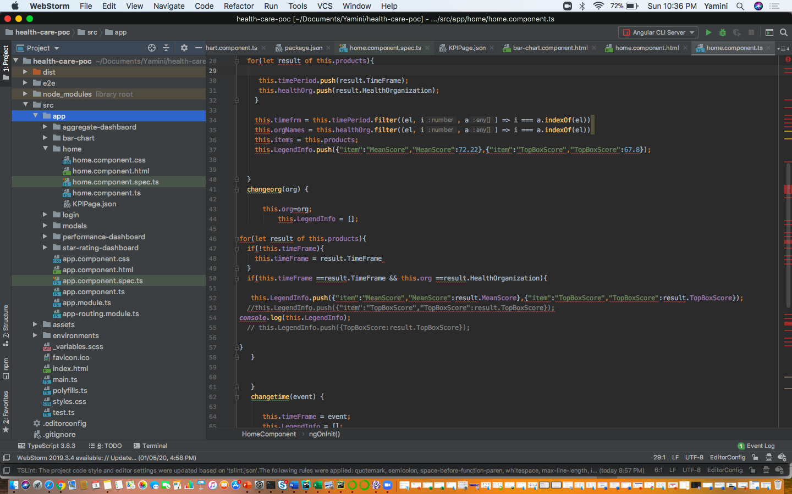
Code Snippets

Slide 25
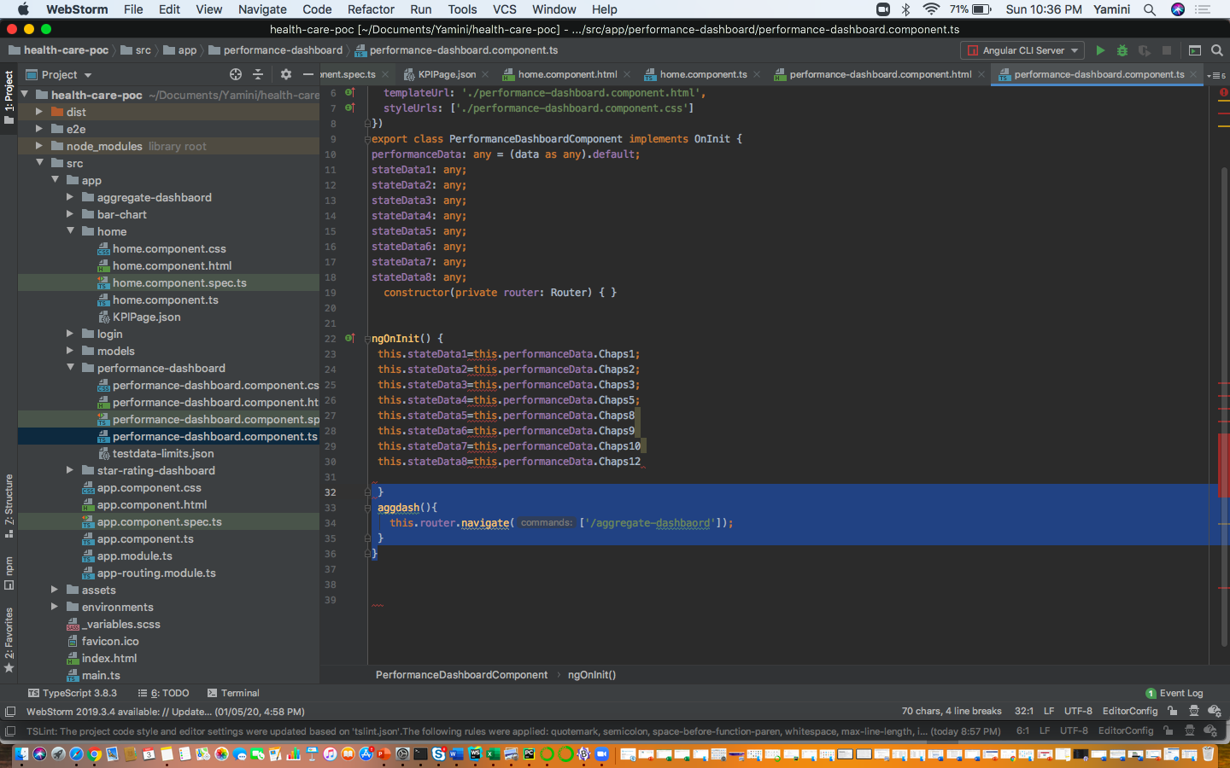
Code Snippets Cont…

Slide 26
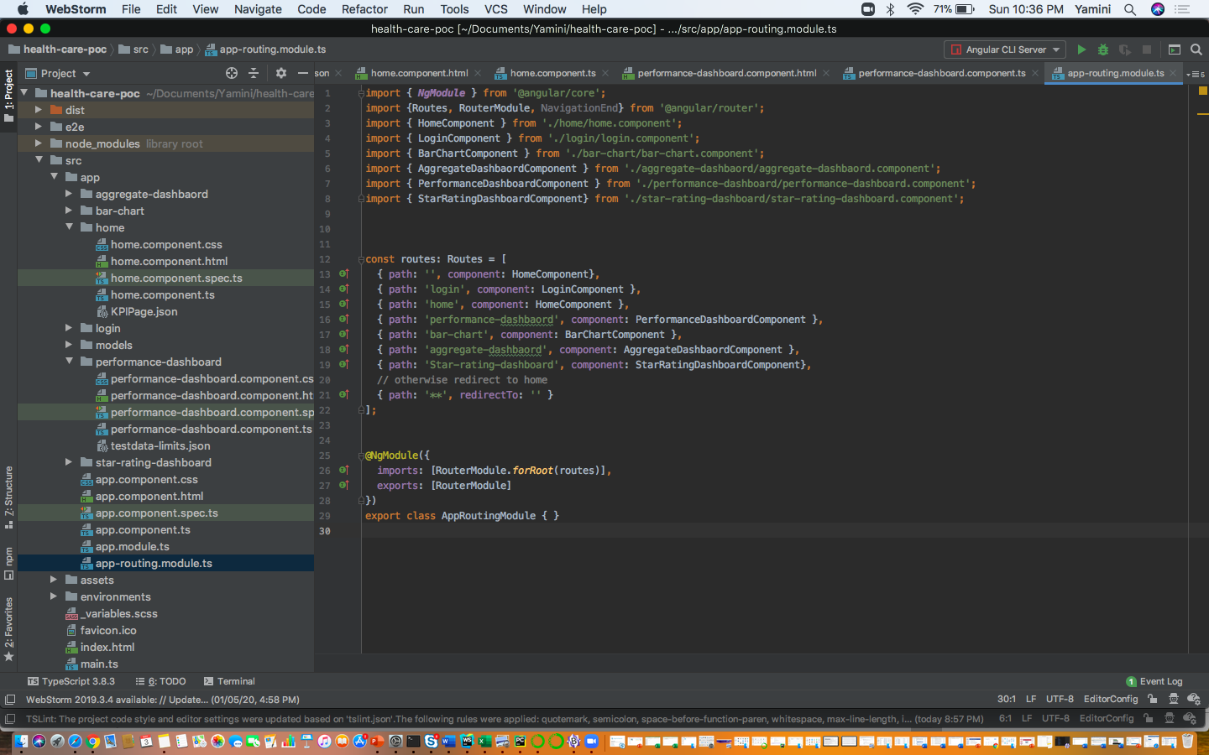
Code Snippets Cont..

Slide 27
Challenges & Approaches
Challenges :
As it’s a survey data, analysis was a complex activity due to large data set.
It really took more effort and time to understand and segregate, and also to finalize the metrics based on available data.
Defining KPIs and applying aggregate logic to derive meaningful insights.
All of the team members are new to Angular and amcharts to build the viz , hence there was a learning curve to build wizards.
New to use AWS and Azure platforms – so, faced initial hiccup's while deploying the application
Approaches :
Initially, we thought of using the Azure Cloud platform directly to develop the visualization’s , to build and deploy directly there. But, we faced some issues and thereby, we have developed an Angular application. For Visualizations , we have have used D3.js in the beginning, but those visualization's weren't colorful. So, we have shifted to amcharts . We also have encountered some issues with the Azure deployment, so again we shifted to AWS for deployment. The overall, experience gave us a real time project exposure.

Slide 28
Project Plan & Contributions
Activity / Phase | Description | ETA | Responsible | Comments
Project Plan
Analysis | Analyze CAHPS Survey data, define KPIs performance measurement | Done | Anusha, Madhuri, Yamini
Design | Design tables, visual charts/components – High level design | Done | Anusha, Madhuri, Yamini
Development | Define tables, data access layer, and visual dashboards and charts | Done | Anusha, Madhuri, Yamini
Validation | Review KPIs and validate the results in dashoards | Done | Yamini, Anusha
Project Presentation | Configure the prototype and presentation along with slides. | Done | Anusha, Madhuri, Yamini
Collaboration Plan
Design Sessions | Meet daily 1 hr to anlayze survey data to define tables, charts and dashboards | Daily | Anusha, Madhuri, Yamini
Meeting | Weekly meeting to review progress on respective deliverables of each member | Weekly | Anusha, Madhuri, Yamini

Slide 29
Individual Learnings & Collaboration Methods
Yamini Reddy – Really understood the cloud platforms very well and I was new to angular and amcharts platform. With this project, I am now able to develop the application successfully.
Anusha – Very new to data analysis. I use to wonder how to analyze the survey data. But, ultimately this project experience gave me an opportunity how the data is crucial to build any application and to understand the foresights.
Madhuri – Initially, very new to the cloud and new done a data analysis project prior. But, now I am now comfortable in understanding the relations and to build the application.
Collaboration Methods:
Initially, we used Whatsup for some days. But, later started using Slack mostly for our communications and we used Zoom for our connects.

Slide 30
Trello Dashboard

Slide 31
Application URL and Github link
Application URL :
http://patient-experience-analytics.s3-website.us-east-2.amazonaws.com/login
Github Link:
https://github.com/madhurisarda/CS5525CloudComputing

Slide 32
Patient Experience Vs Patient Satisfaction - The terms patient satisfaction and patient experience are often used interchangeably, but they are not the same thing. To assess patient experience, one must find out from patients whether something that should happen in a health care setting (such as clear communication with a provider) actually happened or how often it happened.
Satisfaction, on the other hand, is about whether a patient’s expectations about a health encounter were met. Two people who receive the exact same care, but who have different expectations for how that care is supposed to be delivered, can give different satisfaction ratings because of their different expectations.
** Note: The above info is just an extra information **

Slide 33
Summary
Analysed the CAHPS (Consumer Assessment of Healthcare Providers and Systems) Survey Data for health plans or providers and gathered the insights on patient experience. And was successfully able to build an application and showcased all the observations as visualization's in the form of dashboards and deployed into the cloud platform.

Slide 34
References
https://healthdata.gov/dataset/patient-survey-ich-cahps
https://www.ahrq.gov/cahps/cahps-database/index.html
https://www.sgim.org/communities/research/dataset-compendium/consumer-assessment-of-healthcare-providers-and-systems-cahps#

Slide 35
Thank you

